Slide 1
Netflix Analysis
Project 3

Slide 2
Contents
CONTEXT
Background
Approach & Limitations
ANALYSIS
Netflix Overview & Analysis
Recommendations and conclusion
DISCUSSION
Ethical considerations
Ethical solutions & discussion

Slide 3
Background
As Data Analysts, our goal is to provide our stakeholders with a compelling user and business story based on in-depth data analysis on real-life generated data.
Today, we wish to share a story about:
Revenue generation and profitability for Netflix
User preferences with recommendations for Netflix
Ethical considerations for Netflix’s data gathering and consumption

Slide 4
Approach & Limitations
APPROACH
Leveraged public data from Kaggle
Outlined data available
Determined limitations
Formulated hypotheses
Plan our analyses
Decided to only analyze data from 2.5 months
Created thorough plan of action
Conducted analysis
Data modeling and interpretation
Build visualizations
Generate summarized findings
LIMITATIONS
Incomplete data set
Unable to merge data sets to provide age and gender based on preferences (viewing hours, peak viewing time)
Not enough data to fully understand the number of users in each country (i.e., how many users per country, population proportions)
Unable to understand the trends of data distribution
Unable to conduct user research
Many of ethical considerations based on intuition and research; not from sourcing input from users

Slide 5

Netflix market review

Slide 6
Revenue and projection
Netflix has seen an increase in revenue from year to year in the last five years. Comparing 2022 to 2023, the revenue has increased by 42.86%. This year, it already has increased by 16.36% for the first quarter.
With this trajectory, Netflix revenue is very likely to increase.
With more than 270 million subscribers, the subscription number is trending up this continues to engage a vast and diverse user base, signifying its widespread appeal and market penetration.

Slide 7
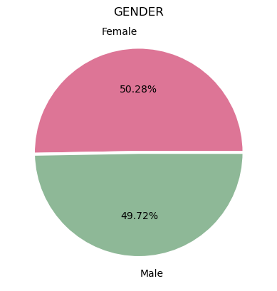
GENDER DISTRIBUTION
Gender Comparison – The gender distribution between male and female is slightly different by 0.28% based on our data.
Both gender almost equally enjoy using Netflix

Slide 8
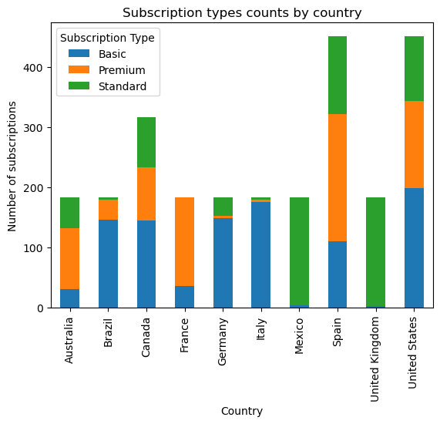
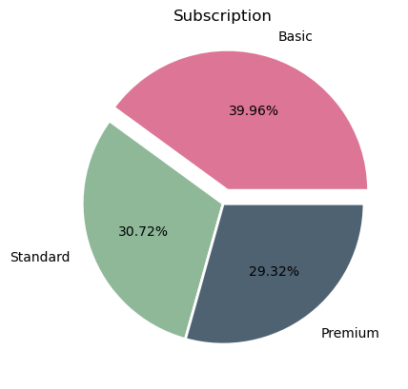
SUBSCRIPTION
Most users of 39.96% subscribed to the basic subscription
Most users who subscribed to basic option were from the United States
Users from the UK and Mexico used only standard subscription – Not clear if they had other options from the data
The standard subscription has the next highest users of 30.72%
Premium subscribers has the least users in Germany, Italy, Brazil and Australia
French and Spanish users subscribe to premium subscriptions

Slide 9
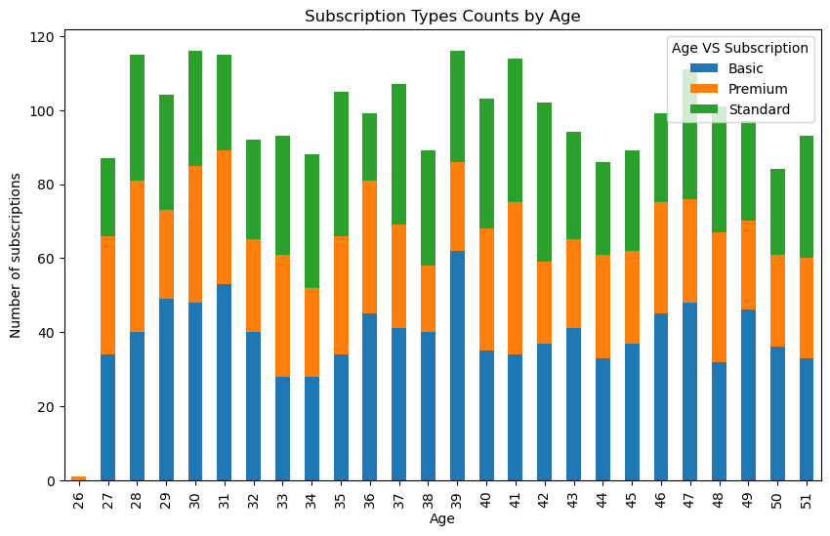
AGE AND SUBSCRIPTION
Correlation between user age and subscription is consistent across all subscription types.
There are more basic users across subscription types , especially, 39 years olds
Except for 26 years olds, who barely have subscription. However, the those who have at all have the premium subscription

Slide 10
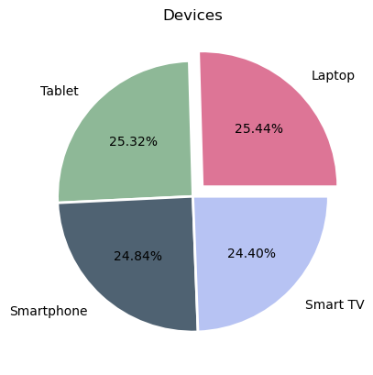
DEVICE USAGE
Devices used by Netflix subscribers does not significantly differ from one another
All four devices are significantly used

Slide 11
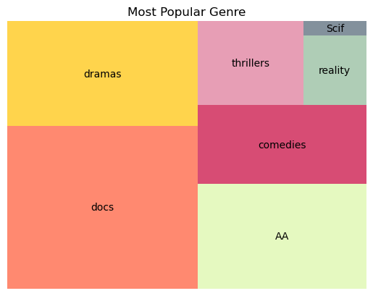
GENRE
Most popular genre is documentaries, according to the data
Action contents are the next popular, followed by drama, then comedies
The least popular content is sci-fi among subscribers

Slide 12
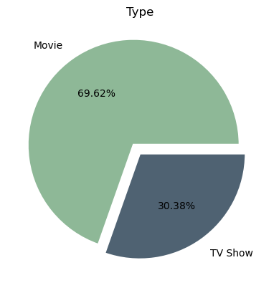
CONTENT TYPES
Most subscribers watch movies than TV shows
69.62%prefer movies while only 30.38% prefer TV shows.
There is no significant data to show the reason users prefer movies to TV shows

Slide 13
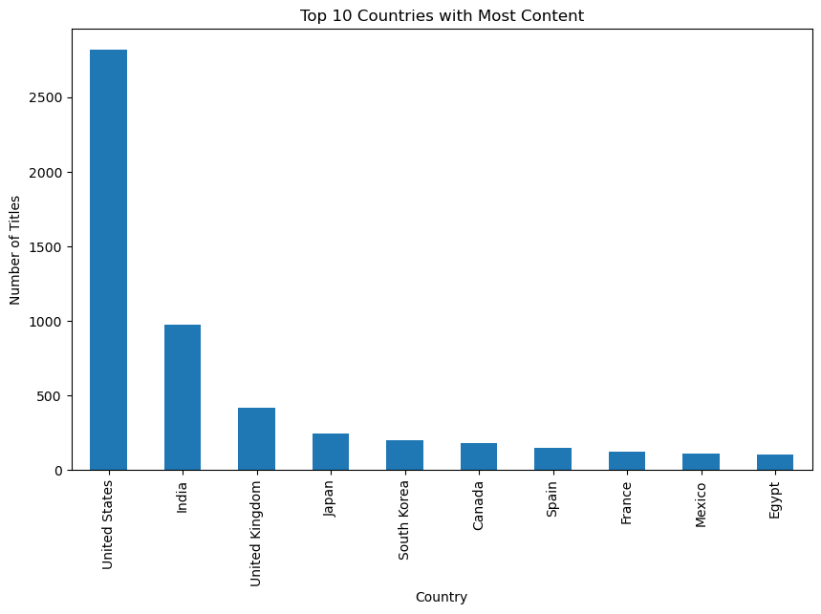
Netflix Content by Country
United States clearly most targeted market for providing different titles and shows
Potentially limited data due to regulatory restrictions on data collection for other countries

Slide 14
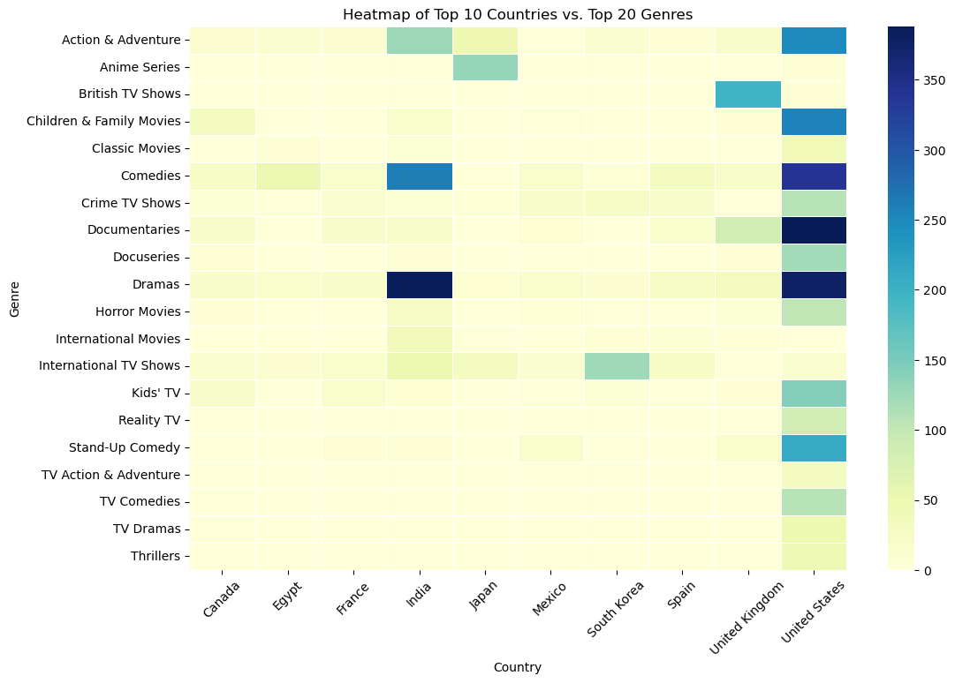
Top Countries compared to Top Genres
Given amount of data available to analyze, easier to identify top genres for US (i.e., Dramas, Documentaries, & Comedies)
India slightly different preferences (i.e., Drama, Comedies, & Action/Adventure)
Japan clearly favors Anime series which correlates to trends seen in market research
Assumption: More content provided correlates to Netflix providing content based on user preferences and trends.

Slide 15
RECOMMENDATIONS
There should be considerable investment in Movies as most subscribers watch more movies than TV shows
Documentaries are widely watched by users. Thus, the company can invest in more documentaries , with the sci-fi being the least to be invested in
Netflix may also invest more in action and drama
The company needs to market premium subscription advantages to users in the UK, Mexico, Italy, Brazil, Germany and Australia

Slide 16

Ethical concern

Slide 17
Ethical considerations
Category
Context
Netflix Considerations
Data Gathering
Is Netflix collecting data with honest consent?
Is it ethical to collect data on an individual and tailor experience?
Users may not be fully aware of the extent of data collection outline in lengthy Terms & Policy, leading to a breach of trust and potential misuse of personal information. Additionally, consistently having same content curated to you limits a user’s ability to expand their knowledge and/or find new preferences.
Data Ownership
Does Netflix own the data they collect?
Do Netflix users understand what’s happening to their data? How it’s used?
Netflix typically states in their terms of service and privacy policy that they collect and own the data generated by user interactions with their platform. While Netflix may legally own the data, the ethical concern is whether Netflix respects user privacy and consent in how this data is collected and used.
Notes:
Data gathering (collecting data without honest consent, multiple user data)
Data ownership (what gives a company a right to claim data, do real people know what’s happening to their data?)

Slide 18
Ethical solutions
Category
Potential Solutions
Data Gathering
Data anonymization; continue to ensure data collected is anonymized before being used for analysis or other purposes.
Improved consent; refine Terms & Policy to clearly explain what data is collected and how it will be used (i.e., survey based vs. lengthy word document to scroll through)
Regular Audits and Compliance Checks; maintain accountability and ensures that data gathering practices remain ethical and compliant with evolving privacy laws and user expectations.
Data Ownership
Federal Privacy Laws; advocate for and comply with stringent federal privacy laws that govern data collection, usage, and ownership
Opt-in for how to use data; create quarterly survey or mechanism to empower users to make informed choices about their data, enhancing trust and aligning with ethical principles of autonomy and consent. It also ensures that users are more engaged and aware of data practices.
Notes:
Data gathering (collecting data without honest consent, multiple user data)
Data ownership (what gives a company a right to claim data, do real people know what’s happening to their data?)

Slide 19
Ethical recommendations
Privacy and consent.
Render data anonymous.
Research on technology to change the data-acquiring rules.
Notes:
By prioritizing privacy and consent, ensuring fairness and accountability, and considering the broader societal impacts of their work, data scientists can harness the power of data responsibly and ethically. The goal should be to create data-driven solutions that not only advance technology but also promote social good and uphold fundamental ethical principles.

Slide 20
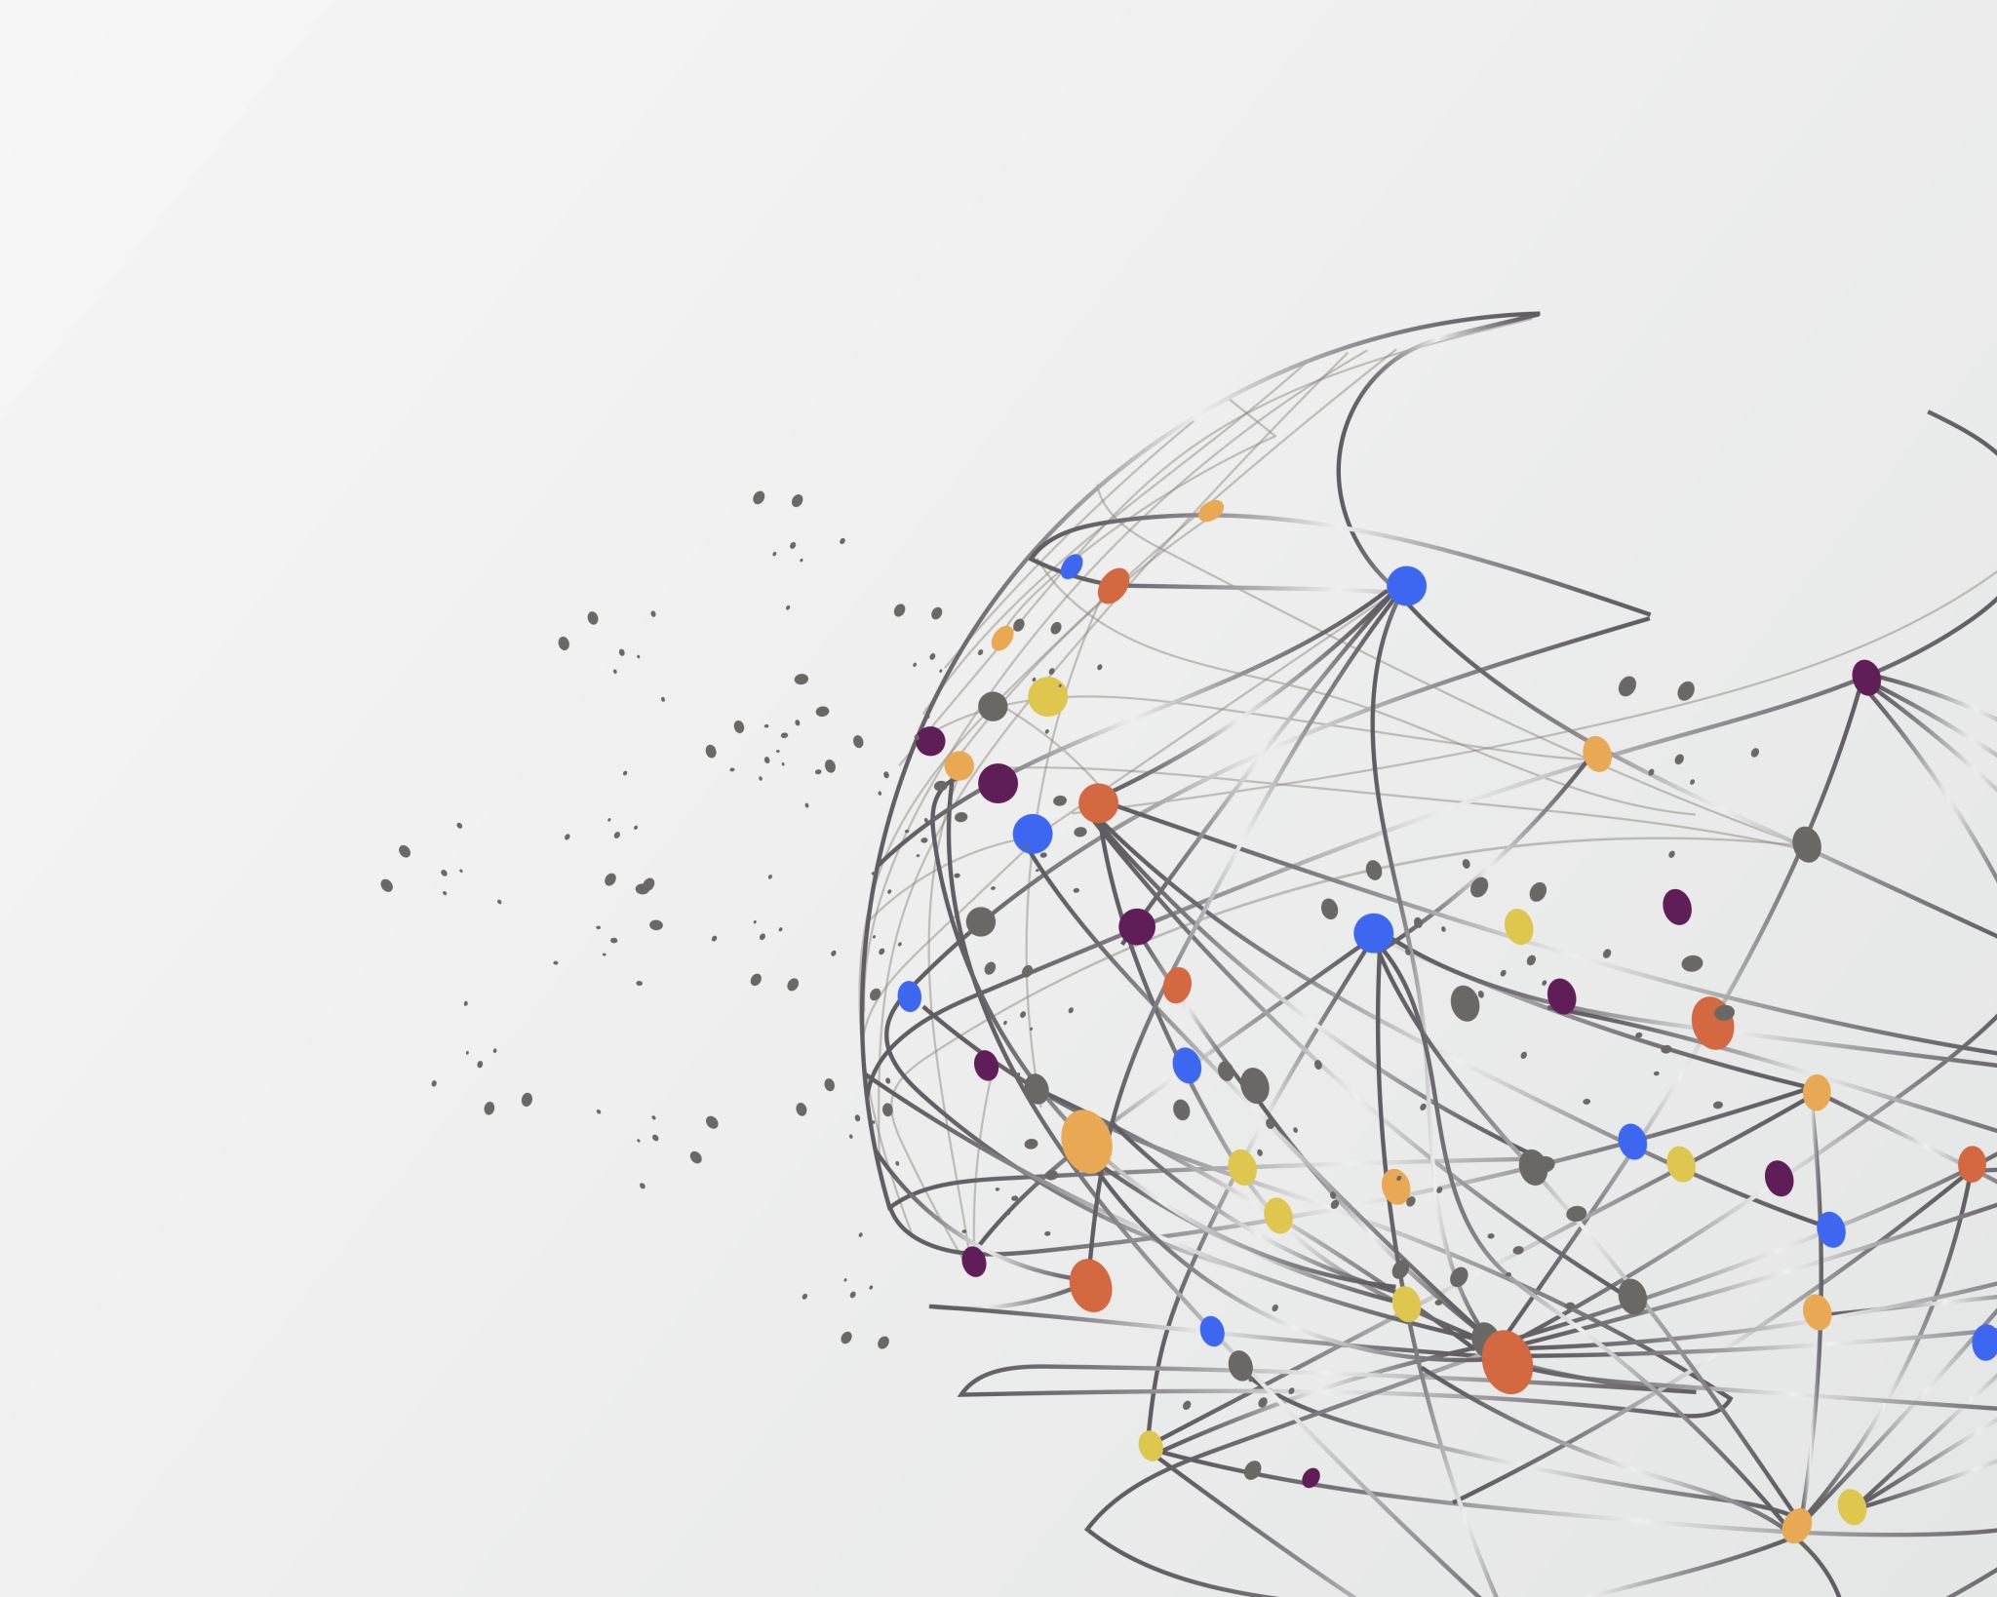
Thank you
Abigail Diche, Alexa Lutz, Brittany Hammond, Lexi Schroeder, Soumik Sarkar , Vlad koledin, Charly Ilunga

